Slide 1
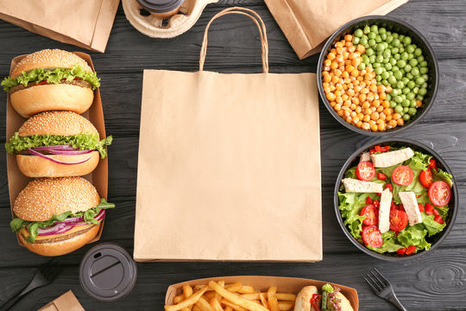

ZOMATO – KANDY A Leaders in the Online Food Delivery Industry.

Slide 2
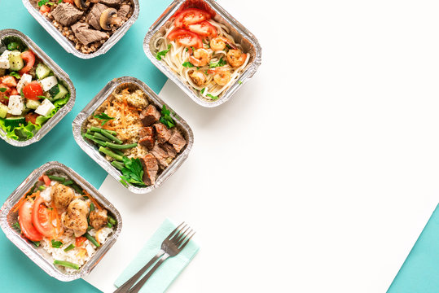
Group Members:
L.M.Y.C. Lansakara – KIC-DCSAI-241-F-001
Amasha Ranasinghe – KIC-DCSAI-241-F-010
Oshadi Ranasinghe – KIC-DCSAI-241-F-019
Hashan Mayura – KIC-DCSAI-241-F-028
Vihanga Prageeth – KIC-DCSAI-241-F-037

Slide 3
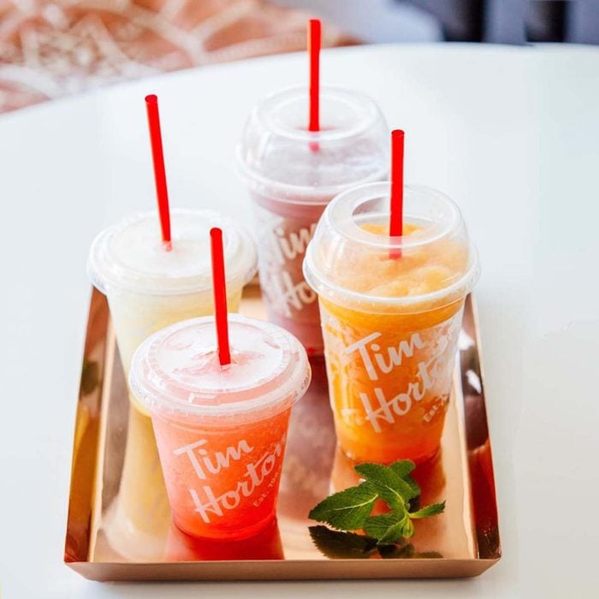
INTRODUCTION:
Welcome to Zomato Kandy,
Where flavor meets convenience! We are thrilled to introduce our mouthwatering selection of pizza, burgers and beverages, curated to satisfy every craving and irresistible special offers. Whether you are a cheese lover, BBQ chicken aficionado, or a veggie enthusiast, we’ve got something special for you. Our commitment to quality ingredients ensures that every bite is packed with deliciousness. From classic favourites like Coca-cola and Pepsi to indulgent hot chocolate, we’ve got the perfect beverage to complement your meal. Join us on a culinary journey and discover why Zomato Kandy is the ultimate destination for online food indulgence. Place your order today and let the feasting begin!

Slide 4
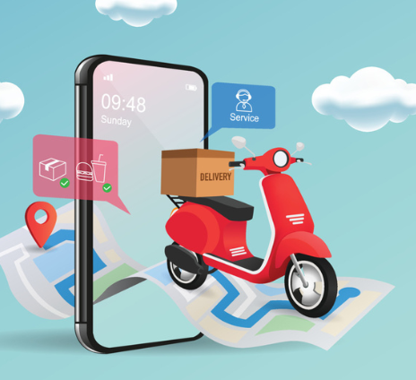
NOW , LET’S MOVE TO SEE OUR
“CPP CODE”

Slide 5

THANK YOU

